Slide 1
Learning Disorders (LD) in the Meteorological Community
Implications for Communication and Education
Matt Bolton, Undergraduate
Pasco-Hernando State
Brooksville, FL
Advised By Greg Blumberg, PhD Student
University Of Oklahoma
Norman, OK

Slide 2
Why Am I Here?
My work motivated by weather camp interactions.
  Focused here on color blindness and Autism Spectrum Disorder (ASD).
Started discussion on learning disorders in relation to how camps are operated.
Asked, “If we’re not thinking of these issues, is anyone in the wider weather enterprise?”

Slide 3
Learning Disability Frequencies
1.7% of Americans have an LD.*
As best I can determine through a variety of sources, 1 in 10 Americans have some degree of color blindness.
Latest numbers indicate 1 in 68 children diagnosed with ASD.*
*Sources: National Center for Learning Disabilities, CDC; 2014

Slide 4
Determining Awareness
Informal survey and discussion with professionals in the enterprise has shown an inherent lack of awareness for LD issues.
  Have found a major lack of awareness and willingness to start discussions on LD topics.
  Why? Because LD can be uncomfortable to discuss.
Because of LD prevalence, this has potential implications for weather education and communication.

Slide 5
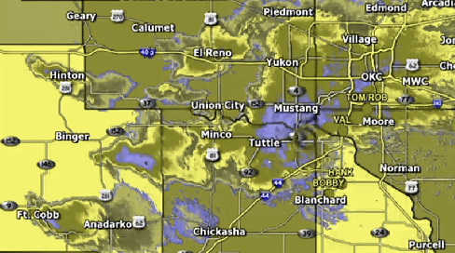
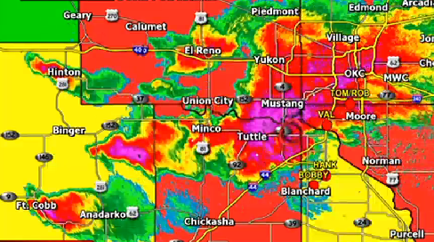
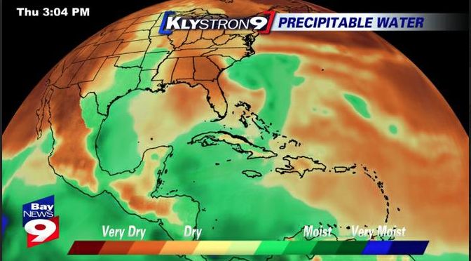
Examples of Poor Color Choices
Can you pick out some key features?
Have to ask the question: are poor color choices forcing ~11% of your viewers to spend more time in life-or-death situations interpreting your graphics than they do taking action?

Slide 6
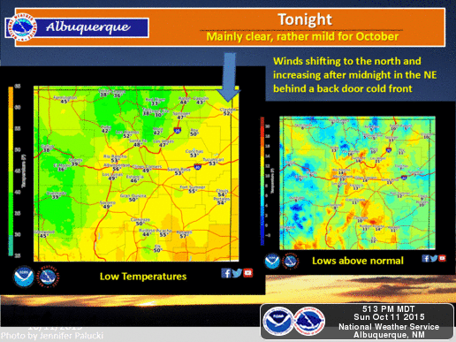
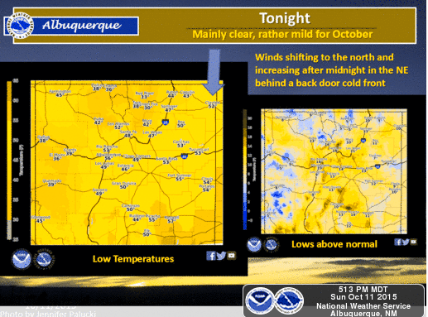
Examples of Poor Color Choices

Slide 7
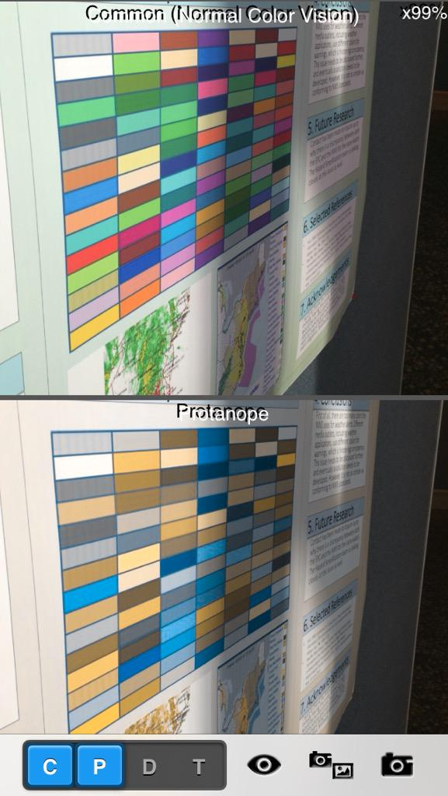
NWS Color Scale

Slide 8
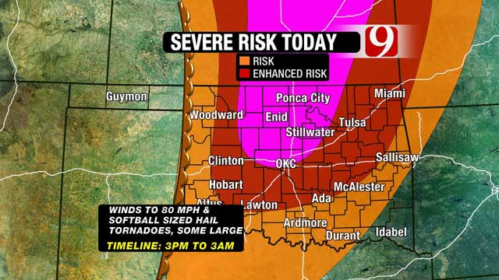
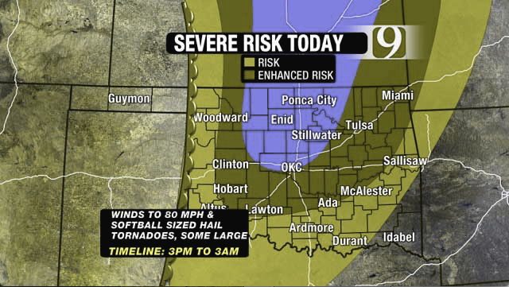
Examples of Good Color Choices

Slide 9
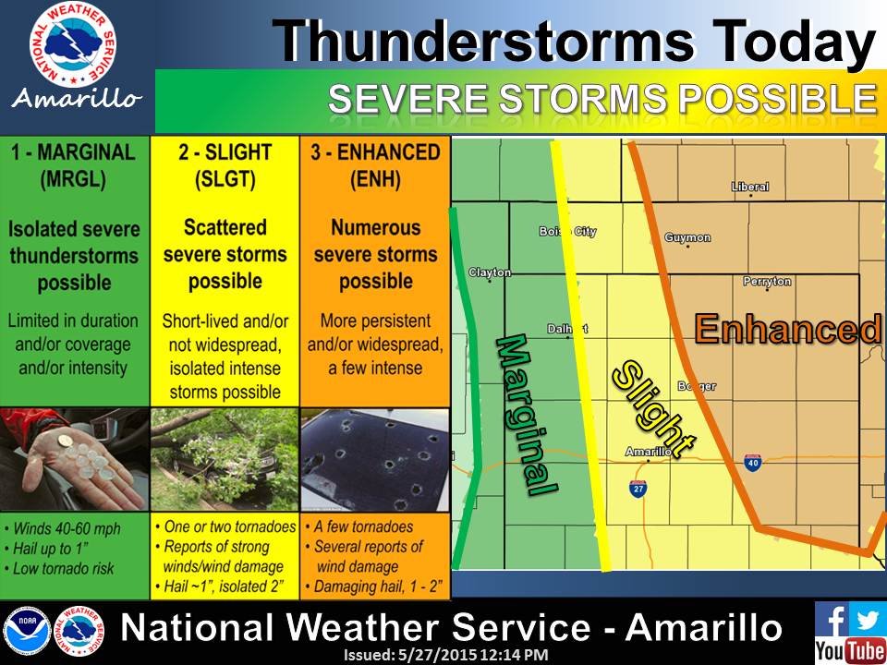
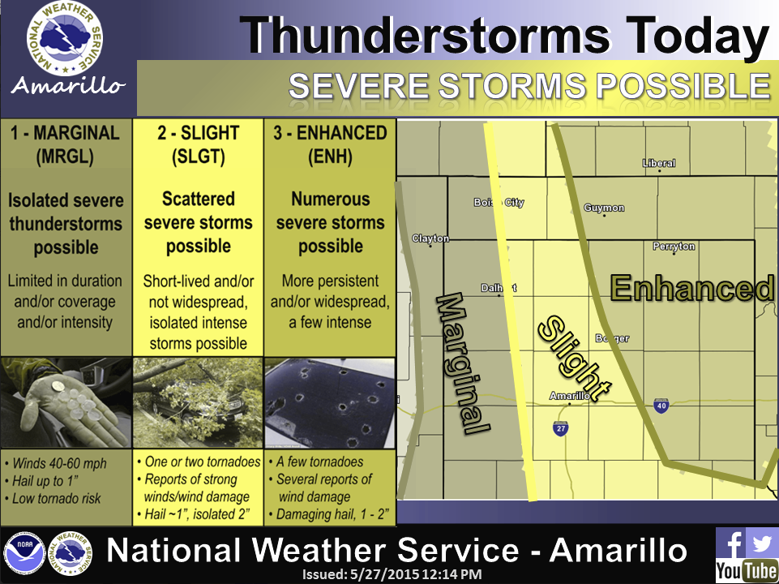
Examples of Good Color Choices

Slide 10
Enhancing Graphics For Color-Blind Audiences
Color-blind-friendly graphics are not widely used.
  What are some free tools/resources to help you simulate color blindness in your graphics?
    CVSimulator (iTunes App Store)
    Color Oracle (Windows/Mac application)
    Spectrum (Google Chrome extension)
    Somewhere Over The Rainbow: How to Make Effective Use of Colors in Meteorological Visualizations (BAMS article)
Things to consider besides color?
  Context of the data
  More efficient ways to differentiate colors in keys/legends and on graphics (i.e., borders, establish strong contrast, etc.)

Slide 11
Autism Spectrum Disorder
A complex neuro-developmental disorder which affects an individual’s ability to communicate.
“High-functioning” to “Low-functioning”
(Less Severe) (More Severe)

Slide 12
Autism Spectrum Disorder
Link to Science Interest?
Baron-Cohen found a link between science interest and ASD with his hyper-systemizing theory. [1]
“Systemizing”
  The drive to analyze or construct systems.
  Systems follow rules and are predictable. The goal of systemizing is to identify the rules in order to predict a particular system’s behavior.
  Are things associated?
mechanical systems (e.g., window lock)
numerical systems (e.g., train timetable)
natural systems (e.g., weather patterns)
social systems (e.g., dance choreography with a partner)

Slide 13
Autism Spectrum Disorder
Theory of Mind and Implications for Communication
Delays in cognitive development
  Theory of Mind
The ability to attribute mental states to oneself and others.
  To understand that others have thoughts, feelings, etc., that are different from one's own.
  Also, inferring what others are thinking so that it is possible to predict their behavior.
How might this affect an individual who has ASD during a severe weather broadcast?
How might they be impacted in an educational setting (i.e., school talk, WFO tour, etc.)?

Slide 14
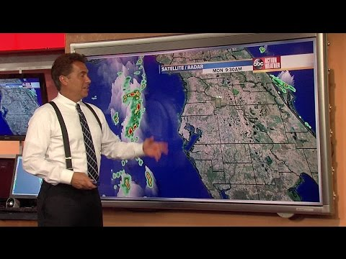
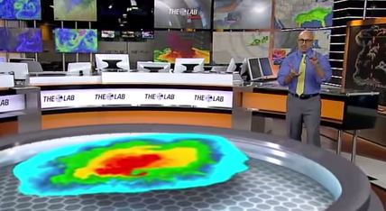
Autism Spectrum Disorder
Implications for Communication
Notes:
Talk about communication processing in autism…. Individuals try to process everything at once. Here are two examples where, because of these factors, extra details take away from the intended message and prevent it from being fully communicated.

Slide 15
Potential Methods To
Better Embrace LD Populations
Workshops and other training opportunities for meteorologists, on how to work with learning disorders in educational environments.
  Professional development / Seal re-certification credit incentive
1:1 mentoring programs within AMS and NWA, tailored for middle and high school students; expand other existing programs.
LD-oriented weather education website

Slide 16
Future Work?
Continue pushing for LD awareness, in the weather enterprise and externally, and pursue opportunities to further LD education efforts.
Run a formal survey of the weather enterprise concerning LD awareness.
Work in conjunction with members of the weather enterprise and social science community to implement specialized science education programs which would be beneficial to LD populations.

Slide 17
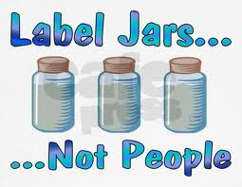
One Final Thought, In Closing….
“No one is perfect or normal. […disorders] are just the features that make you who you are.”

Slide 18
Special Thanks To…
Jodi Savell
Naomi Curtis
Mike Mogil
Brian LaMarre
Lynnette Grant
Dr. Daphne LaDue
For feedback and content ideas, inspiration, topic discussion, literature insight, and general support of the project.
[1] Baron-Cohen, S et al.(2009).
Talent in autism:
Hyper-systemizing, hyper-attention to detail and sensory hypersensitivity. Philosophical Transactions B, 364(1522). doi:1098/rstb.2008.0337

Slide 19
Discussion Time!
Matt.Bolton@weatherworks.com
@mboltonwx on Twitter
Find resources on learning disorders, and blog articles on autism awareness at
www.MattBolton.me
Your turn!
Questions, suggestions, comments, or other thoughts?

